Slide 1
TERM PROJECT: BA840
Team: ALL STARS
Yash, Xi, Shadman, Lin

Slide 2
General system setup and its sub-systems
Customer
Employee
Department
Supplier
Warehouse
Product_Type
Product
Sales_Channel
Invoice
Payment

Slide 3
Description of the various sub-system business rules
Customer-Payments: Customer table has an one to many relationship with the payments table.
Customer-Invoice: Customer table has a one to many relationship with the invoice table.
Invoice-Employee: Invoice table has a one to many relationship with the employee table.
Department-Employee: Department table has a one to many relationship to the employee table.
Sales Channel-Invoice: Sales channel table has a one to many relationship with the invoice table.
Invoice-Product: Invoice table has a one to many relationship with the product table.
Supplier-Product: Supplier table has one to many relationship with the product table.
Product type-Product: Product type table has a one to many relationship with the product table.
Warehouse-Product: Warehouse table has a one to many relationship with the product table.

Slide 4
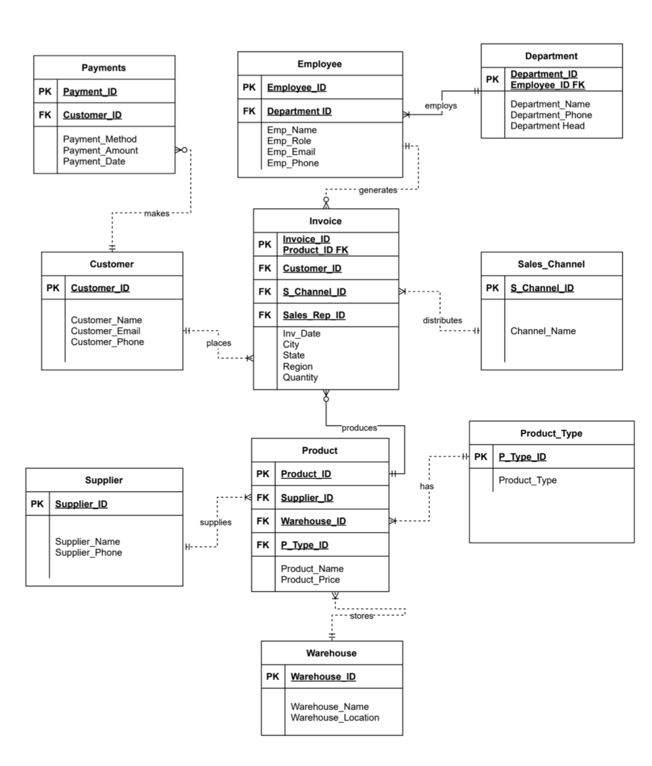
Entity Relationship Diagram

Slide 5
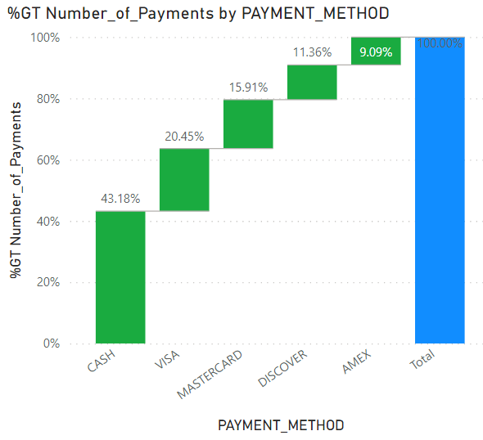
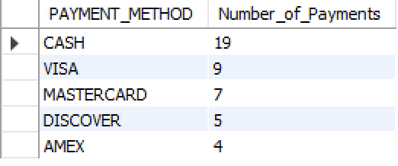
Summary
Query:
SELECT PAYMENT_METHOD, COUNT(*) AS NUMBER_OF_PAYMENTS
FROM TPPAYMENTS
GROUP BY PAYMENT_METHOD
ORDER BY NUMBER_OF_PAYMENTS DESC;

Slide 6

Query:
SELECT CITY, CHANNEL_NAME ,COUNT(INVOICE_ID) AS SALES
FROM TPINVOICE I, TPSALES_CHANNEL SC
WHERE I.S_CHANNEL_ID=SC.S_CHANNEL_ID
AND CITY = 'NEW YORK'
AND CHANNEL_NAME='BESTBUY'
GROUP BY CITY, CHANNEL_NAME;

Slide 7
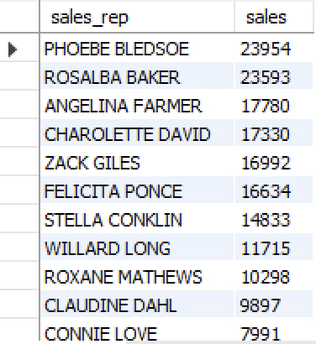
Query:
SELECT EMPLOYEE_NAME AS SALES_REP, SUM(QUANTITY*PRODUCT_PRICE) AS SALES
FROM TPEMPLOYEE E, TPINVOICE I, TPPRODUCT P
WHERE E.EMPLOYEE_ID=I.SALES_REP_ID
AND I.PRODUCT_ID=P.PRODUCT_ID
GROUP BY SALES_REP
ORDER BY SALES DESC;

Slide 8

Query:
SELECT SUPPLIER_NAME , COUNT(PRODUCT_NAME) AS NUMBER_OF_PRODUCTS
FROM TPSUPPLIER S, TPPRODUCT P
WHERE S.SUPPLIER_ID = P.SUPPLIER_ID
GROUP BY SUPPLIER_NAME
ORDER BY NUMBER_OF_PRODUCTS DESC
LIMIT 1;

Slide 9
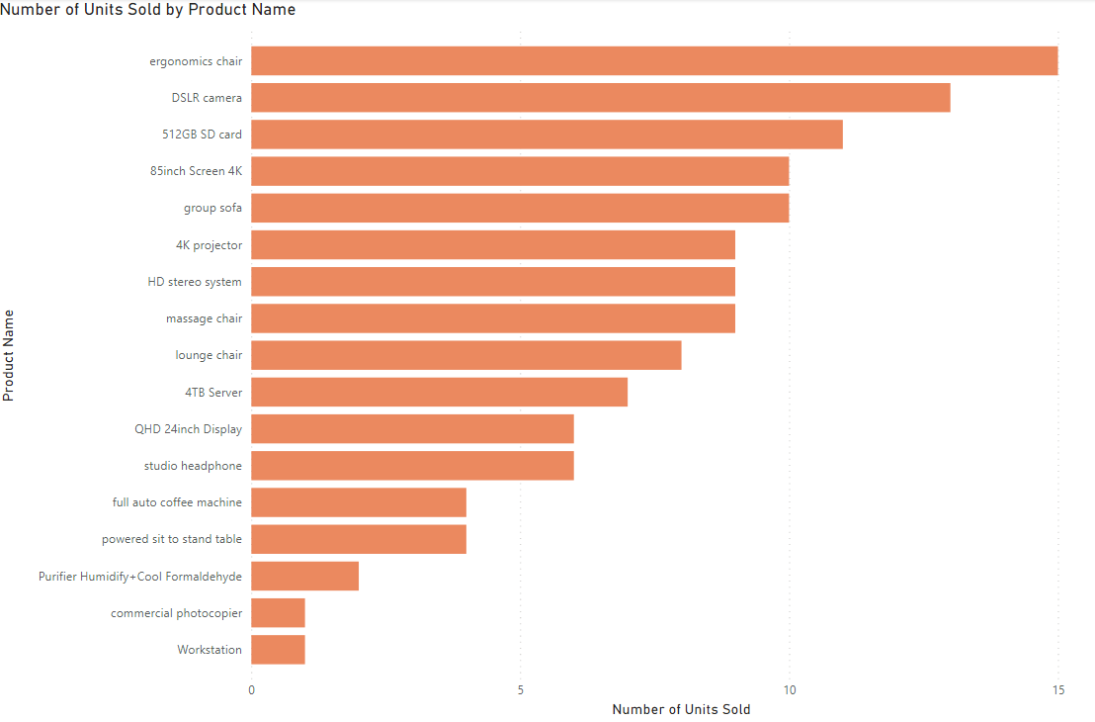
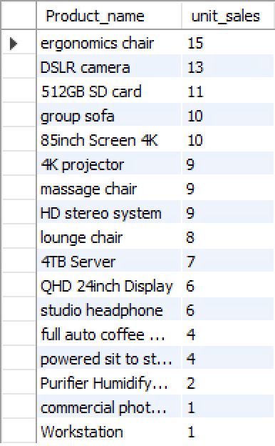
Query:
SELECT PRODUCT_NAME, SUM(QUANTITY) AS UNIT_SALES
FROM TPPRODUCT P, TPINVOICE I
WHERE P.PRODUCT_ID=I.PRODUCT_ID
GROUP BY PRODUCT_NAME
ORDER BY UNIT_SALES DESC;

Slide 10
Query:
SELECT AVG(PAYMENT_AMOUNT) AS AVERAGE_PAYMENT, MIN(PAYMENT_AMOUNT) AS MINIMUM_PAYMENT, MAX(PAYMENT_AMOUNT) AS MAXIMUM_PAYMENT,
STD(PAYMENT_AMOUNT) AS PAYMENT_STANDARD_DEVIATION
FROM TPPAYMENTS;

Slide 11
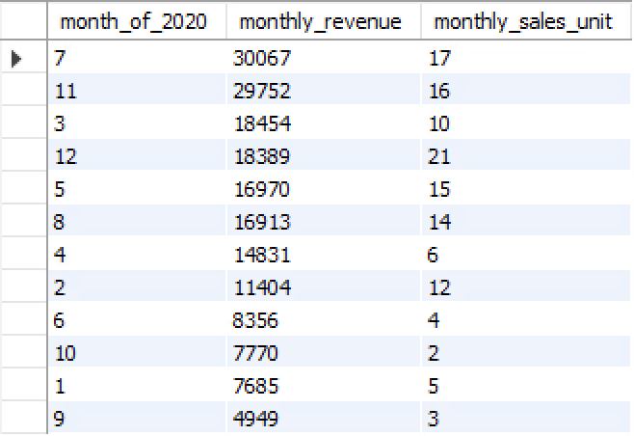
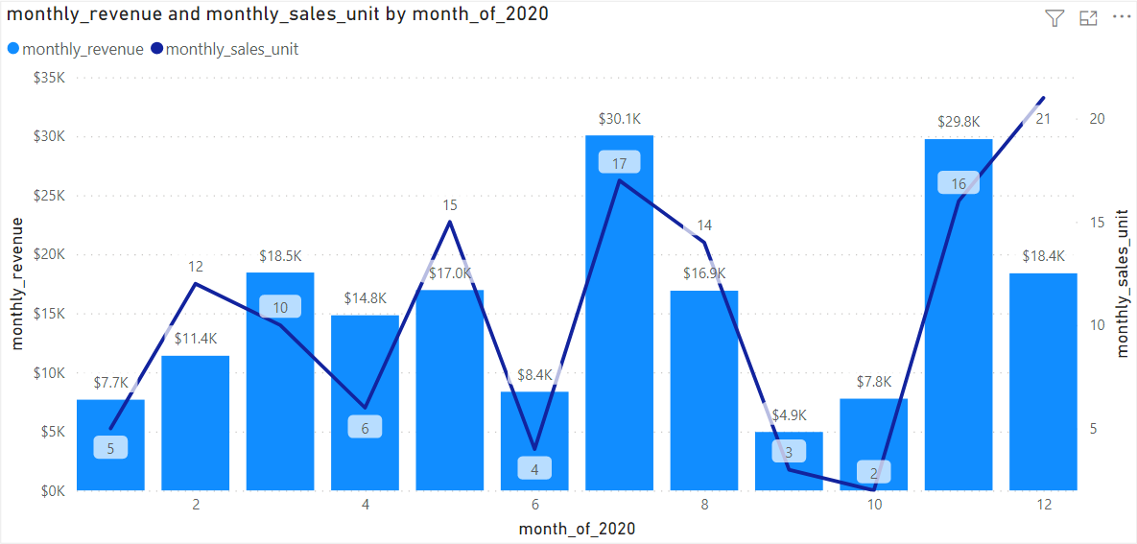
Query:
SELECT MONTH(INV_DATE) AS MONTH_OF_2020, SUM(QUANTITY*PRODUCT_PRICE) AS MONTHLY_REVENUE, SUM(QUANTITY) AS MONTHLY_SALES_UNIT
FROM TPINVOICE TI, TPPRODUCT TP
WHERE TI.PRODUCT_ID=TP.PRODUCT_ID
GROUP BY MONTH_OF_2020
ORDER BY MONTHLY_REVENUE DESC;

Slide 12
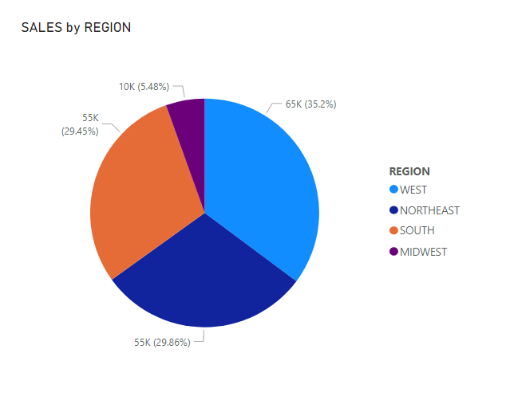
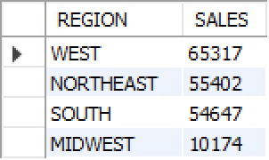
Query:
SELECT REGION, SUM(QUANTITY* PRODUCT_PRICE) AS SALES
FROM TPPRODUCT P, TPINVOICE I
WHERE P.PRODUCT_ID = I.PRODUCT_ID
GROUP BY REGION
ORDER BY SALES DESC;

Slide 13

Query:
SELECT COUNT(*) AS NUMCUS_ABOVE_AVERAGE
FROM
(SELECT CUSTOMER_NAME, SUM(QUANTITY*PRODUCT_PRICE) AS REVENUE
FROM TPINVOICE I, TPCUSTOMER C, TPPRODUCT P
WHERE I.CUSTOMER_ID=C.CUSTOMER_ID
AND I.PRODUCT_ID=P.PRODUCT_ID
AND REGION="WEST"
GROUP BY CUSTOMER_NAME
HAVING REVENUE > AVG(QUANTITY*PRODUCT_PRICE)
ORDER BY REVENUE DESC) AS PURCHASE;

Slide 14

Query:
SELECT COUNT(INVOICE_ID)/COUNT(*) AS SALES_WINTER
FROM TPINVOICE
WHERE INV_DATE BETWEEN '2020-10-1' AND '2021-2-1';

Slide 15
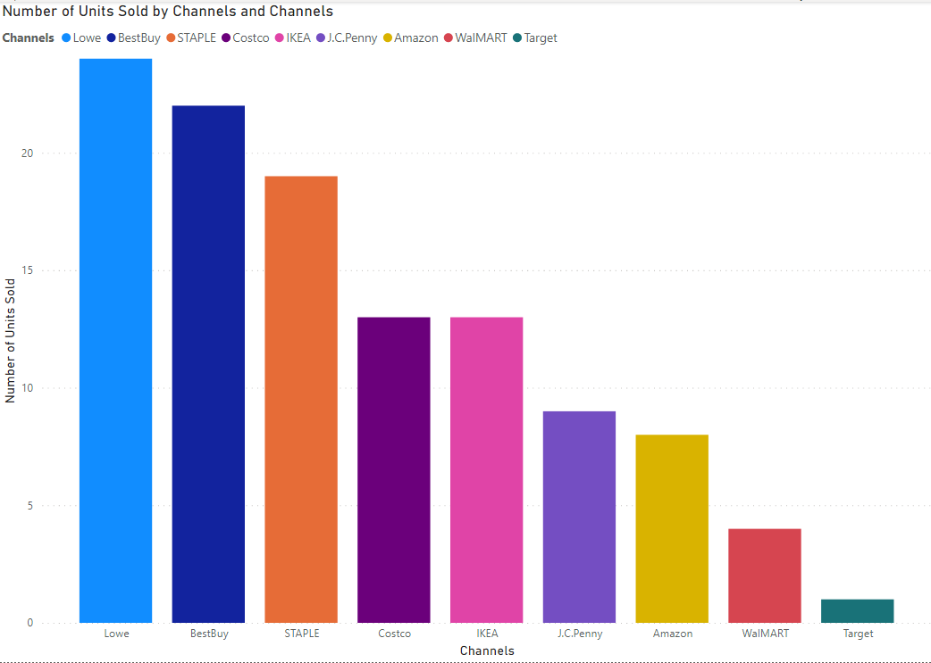
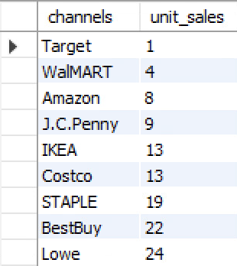
Query:
SELECT CHANNEL_NAME AS CHANNELS, SUM(QUANTITY) AS UNIT_SALES
FROM TPINVOICE TI,TPPRODUCT TP, TPSALES_CHANNEL TS
WHERE TI.PRODUCT_ID=TP.PRODUCT_ID AND TI.S_CHANNEL_ID=TS.S_CHANNEL_ID
GROUP BY CHANNELS
ORDER BY UNIT_SALES ASC;

Slide 16
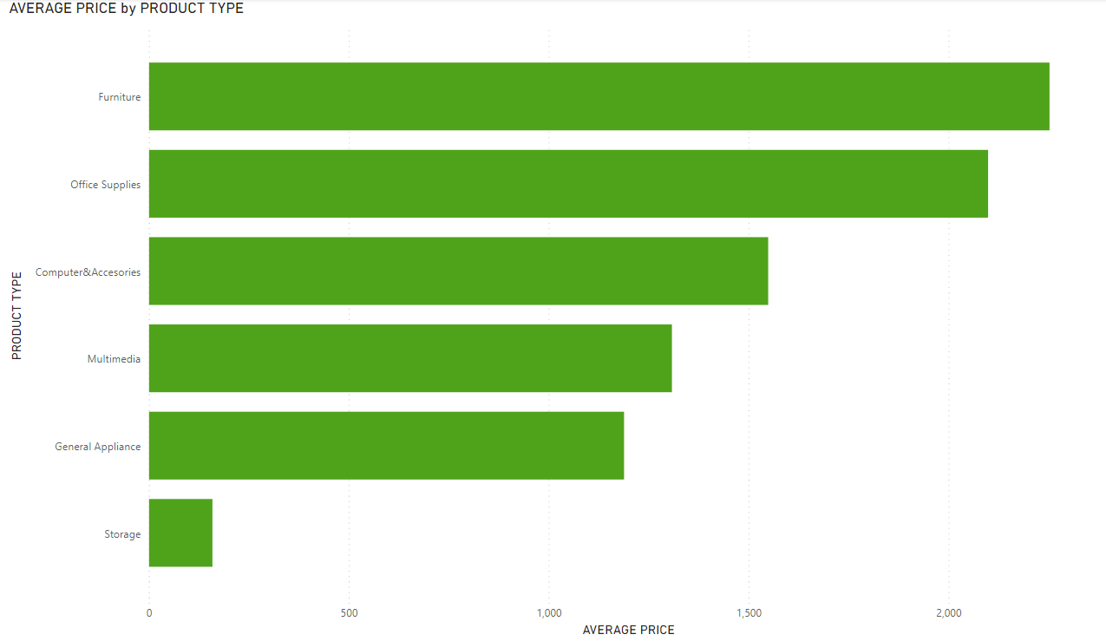
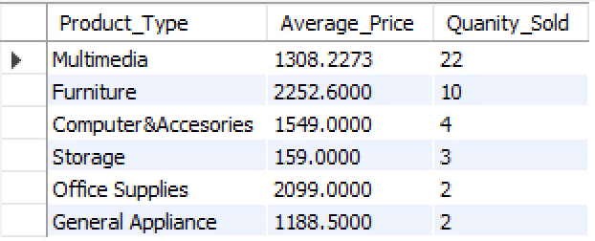
Query:
SELECT PRODUCT_TYPE, AVG(PRODUCT_PRICE) AS AVERAGE_PRICE, COUNT(P.PRODUCT_ID) AS QUANITY_SOLD
FROM TPPRODUCT P, TPPRODUCT_TYPE PT, TPINVOICE IV
WHERE P.P_TYPE_ID = PT.P_TYPE_ID
AND IV.PRODUCT_ID = P.PRODUCT_ID
GROUP BY PRODUCT_TYPE
ORDER BY QUANITY_SOLD DESC;

Slide 17
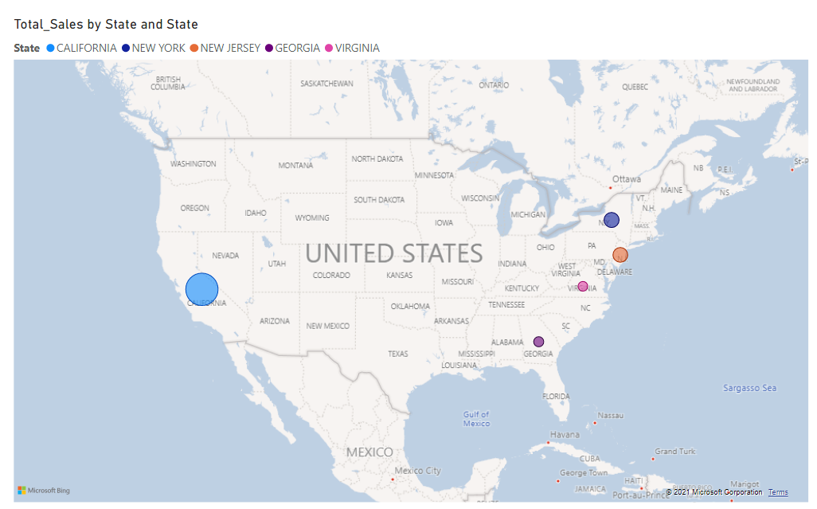
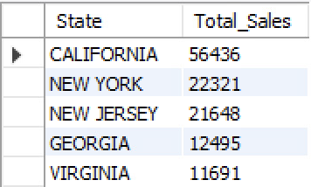
Query:
SELECT STATE, SUM(QUANTITY*PRODUCT_PRICE) AS TOTAL_SALES
FROM TPINVOICE IV, TPPRODUCT PD
WHERE IV.PRODUCT_ID = PD.PRODUCT_ID
GROUP BY STATE
ORDER BY TOTAL_SALES DESC
LIMIT 5;

Slide 18
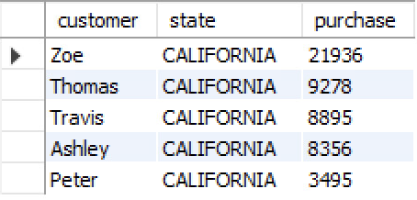
Query:
SELECT CUSTOMER_NAME AS CUSTOMER, STATE, SUM(QUANTITY*PRODUCT_PRICE) AS PURCHASE
FROM TPINVOICE TI, TPCUSTOMER TC, TPPRODUCT TP
WHERE TI.CUSTOMER_ID=TC.CUSTOMER_ID
AND TI.PRODUCT_ID=TP.PRODUCT_ID
AND STATE='CALIFORNIA'
GROUP BY CUSTOMER
ORDER BY PURCHASE DESC
LIMIT 5;

Slide 19
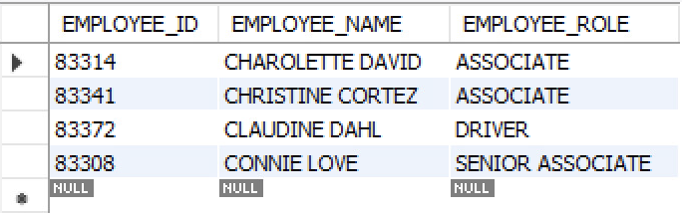
Query:
SELECT EMPLOYEE_ID, EMPLOYEE_NAME, EMPLOYEE_ROLE
FROM TPEMPLOYEE
WHERE EMPLOYEE_NAME LIKE 'C%'
ORDER BY EMPLOYEE_NAME ASC;

